Slide 1
Computer Organisation and Architecture
Introduction to Computer
Architecture
MR. SOLOMON ANAB

Slide 2
A Note on Hardware vs. Software
This course is classified under “Computer Hardware”
However, you will be much more capable if you master both hardware and software (and the interface between them)
  Can develop better software if you understand the underlying hardware
  Can design better hardware if you understand what software it will execute
  Can design a better computing system if you understand both
This course covers the HW/SW interface and microarchitecture
  We will focus on tradeoffs and how they affect software

Slide 3
INTRODUCTION
In this unit, we will discuss how the data is fed to the computer and
the way they are being processed, that is, how the data is being
transferred to and from the external devices to the CPU and the memory.
MR. SOLOMON ANAB

Slide 4
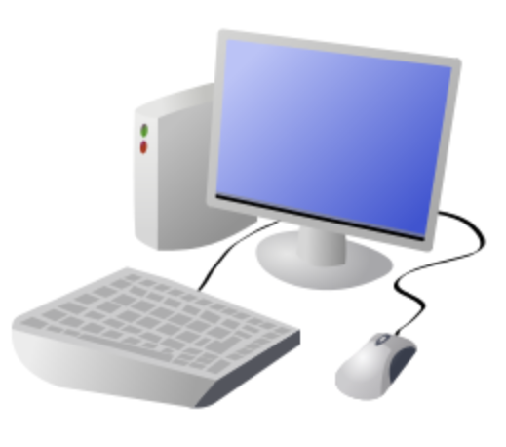

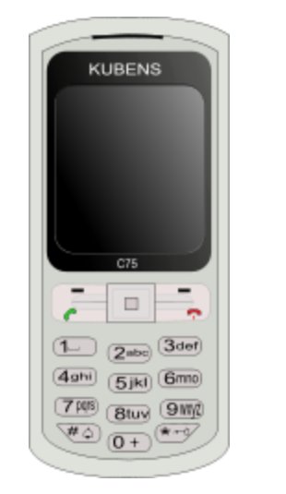
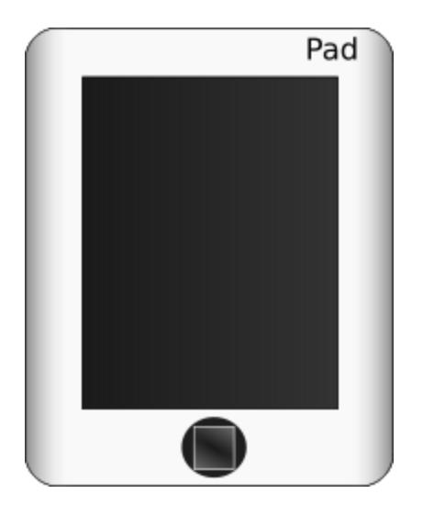

What is a Computer ?
A computer is a general purpose device that can be programmed to process
information, and yield meaningful results.
MR. SOLOMON ANAB

Slide 5
How does it work ?
Information
store
Program
Computer
results
Program – List of instructions given to the computer
Information store – data, images, files, videos
Computer – Process the information store according to the instructions in the program
MR. SOLOMON ANAB

Slide 6
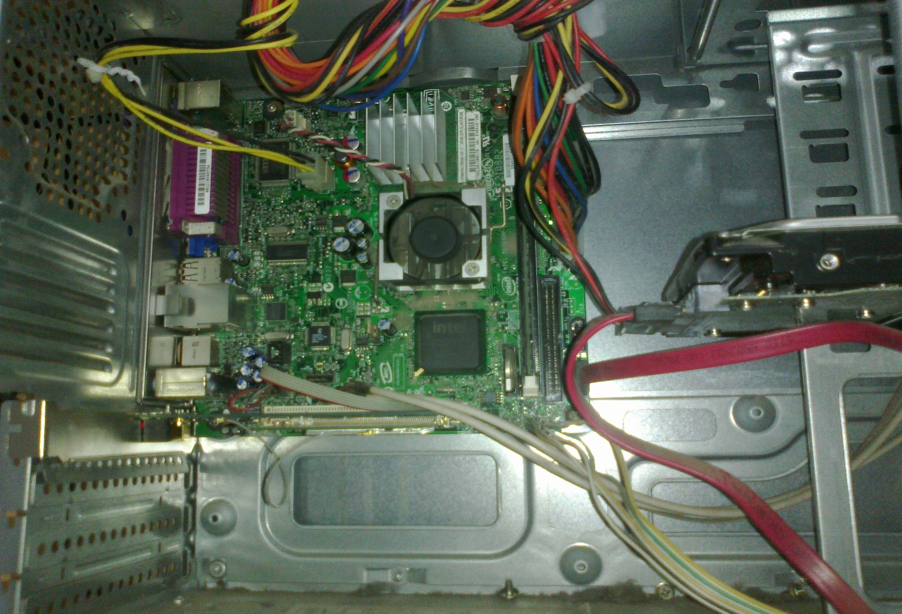
What does a computer look like ?
Let us take the lid off a desktop computer
CPU
Hard disk
Memory
MR. SOLOMON ANAB

Slide 7
Memory
Hard disk
Computer
Memory – Stores programs and data. Gets destroyed when the computer is powered off
Hard disk – stores programs/data permanently
MR. SOLOMON ANAB

Slide 8
Let us make it a full system ...
Memory
Hard disk
Computer
Keyboard
Monitor
Mouse
Printer
MR. SOLOMON ANAB

Slide 9
How to Instruct a Computer ?
compile
execute
Program
Executable
Output
Write a program in a high level language – C, C++, Java
Compile it into a format that the computer understands
Execute the program
MR. SOLOMON ANAB

Slide 10
What Can a Computer Understand ?
Computer can clearly NOT understand instructions of the form
  Multiply two matrices
  Compute the determinant of a matrix
  Find the shortest path between Mumbai and Delhi
They understand :
  Add a + b to get c
  Multiply a * b to get c
MR. SOLOMON ANAB

Slide 11
The Language of Instructions
Humans can understand
  Complicated sentences
    English, French, Spanish
Computers can understand
  Very simple instructions
The semantics of all the instructions supported by a processor is known
as its instruction set architecture (ISA). This includes the semantics of
the instructions themselves, along with their operands, and interfaces
with peripheral devices.
MR. SOLOMON ANAB

Slide 12
What is Computer Architecture ?
The science and art of designing, selecting, and interconnecting hardware components and designing the hardware/software interface to create a computing system that meets functional, performance, energy consumption, cost, and other specific goals.
It deals with software and hardware technology standards. The computer system has the processor, memory, I/O devices and communication channels that connect to it.
MR. SOLOMON ANAB

Slide 13
Why Study Computer Architecture?
Enable better systems: make computers faster, cheaper, smaller, more reliable, …
  By exploiting advances and changes in underlying technology/circuits
Enable new applications
  Life-like 3D visualization 20 years ago?
  Virtual reality?
  Personal genomics?
Enable better solutions to problems
  Software innovation is built into trends and changes in computer architecture
    > 50% performance improvement per year has enabled this innovation
Understand why computers work the way they do

Slide 14
Computer Architecture Today (I)
Today is a very exciting time to study computer architecture
Industry is in a large paradigm shift (to multi-core and beyond) – many different potential system designs possible
Many difficult problems motivating and caused by the shift
  Power/energy constraints
  Complexity of design → multi-core?
  Difficulties in technology scaling → new technologies?
  Memory wall/gap
  Reliability wall/issues
  Programmability wall/problem
No clear, definitive answers to these problems

Slide 15
Computer Architecture Today (II)
You can revolutionize the way computers are built, if you understand both the hardware and the software (and change each accordingly)
You can invent new paradigms for computation, communication, and storage

Slide 16
Types of Computer Architecture
Given below are the types of Computer Architecture:
1. Von-Neumann Architecture
This architecture is proposed by john von-neumann. Now a day’s computer we are using are based on von-neumann architecture. It is based on some concepts.
The memory we have a single read/write memory available for read and write instructions and data. When we talk about memory, it is nothing but the single location which is used for reading and writing instructions for the data and instructions are also present in it. Data and instructions are stored in a single read/write memory within the computer system.
Each memory has multiple locations and each location has a unique address.
MR. SOLOMON ANAB

Slide 17
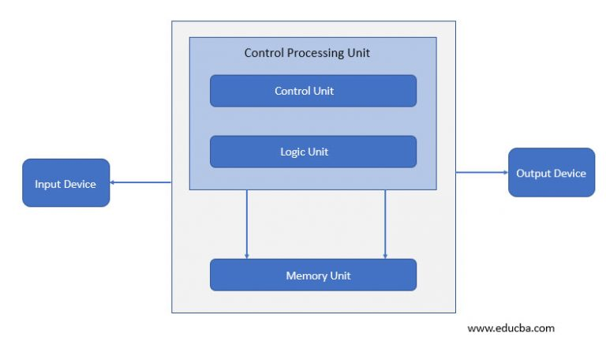
Types of Computer Architecture (Cont.)
Von-Neumann Architecture
MR. SOLOMON ANAB

Slide 18
The von Neumann Model (of a Computer)
MEMORY
Mem Addr Reg
Mem Data Reg
PROCESSING UNIT
INPUT
OUTPUT
ALU
TEMP
CONTROL UNIT
IP
Inst Register

Slide 19
There is a bus (address bus/data bus/control bus) used for the instruction and data code execution. Input device takes data or instruction and the Central processing unit (CPU) performs one operation at a time, either fetching data or instruction in/out of the memory.
Once the operation is done it is sent to the output device. Control and logic units for processing operations are within the central processing unit.
MR. SOLOMON ANAB

Slide 20
2. Harvard Architecture
Harvard architecture is used when data and code is present in different memory blocks. A separate memory block is needed for data and instruction. Data can be accessed by one memory location and instruction can be accessed by a different location. It has data storage entirely contained within the central processing unit (CPU). A single set of clock cycles is required. The pipeline is possible. It is complex to design. CPU can read and write instructions and process data access.
Harvard architecture has different access codes and data address spaces that is, the instruction address zero is not the same as data address zero. Instruction address zero identifies 24-byte value and data address zero identifies 8-byte value which is not the part of the 24-byte value.
MR. SOLOMON ANAB

Slide 21
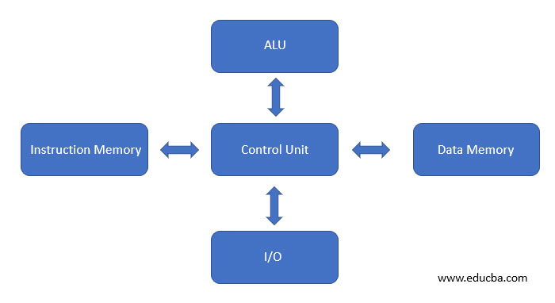
We can observe in the below image, there are separate data and instruction memory that is a bus available to perform operations. It is contained entirely within the Central processing unit. It can perform Input/output operation simultaneously and it has a separate arithmetic and logic unit.
Harvard Architecture
MR. SOLOMON ANAB

Slide 22
3. Instruction Set Architecture
To make up the architecture, instruction set architecture is needed because it has a set of instructions that the processor understands. It has two instruction set one is RISC (reduced instruction set computer) and the second is CISC (complex instruction set computer).
MR. SOLOMON ANAB

Slide 23
4. Microarchitecture
Microarchitecture is known as computer organizations and it is the way when instruction set architecture is a built-in processor. Instruction set architecture is implemented with various microarchitecture and it varies because of changing technology.
Microarchitecture performs in a certain way. It reads the instruction and decodes it, will find parallel data to process the instruction and then will process the instruction and output will be generated.
It is used in microprocessors, microcontrollers. Some architectures overlap multiple instructions while executing but this does not happen in microarchitecture.
MR. SOLOMON ANAB

Slide 24
5. System Design
The name defines itself, the design will satisfy user requirements such as architecture, module, interfaces and data for a system and it is connected to product development. It is the process of taking marketing information and creating product design to be manufacture. Modular systems are made by standardizing hardware and software.
MR. SOLOMON ANAB

Slide 25
INPUT- OUTPUT DEVICES
Input devices enter data and instructions into the computer for processing and the output devices display the result obtained for the users to see. The input-output devices attached to the computer are also known as peripherals. There are three types of peripherals: input, output and input-output peripherals.
MR. SOLOMON ANAB

Slide 26
INPUT- OUTPUT DEVICES (cont.)
Most common peripherals are :
• Keyboard,
• Monitor,
• Printers,
• The auxiliary storage devices such as magnetic disks and tapes.
MR. SOLOMON ANAB

Slide 27
FUNCTIONS
Keyboard and Monitor :
Keyboard allows the user to enter alphanumeric information. On pressing a key, a binary coded character, typically 7 or 8 bits in length is sent to the computer. The most commonly used code is a 7-bit code referred to as ASCII ( American Standard Code For Information Interchange).
Each character in this code is represented by a unique 7-bit binary code; thus a total of 128 different characters
MR. SOLOMON ANAB

Slide 28
MONITOR
Video monitors may be of different types but most commonly used one
is the CRT (Cathode Ray Tube) monitors. Another one that becomes
popular now-a-days is LCD (Liquid Crystal Display) monitor.
The monitor displays a cursor on the screen which marks the position
on the screen where the next character is to be inserted.
MR. SOLOMON ANAB

Slide 29
Printers :
Printers produce a hard copy of the output data. Based on the technology
used printers may be either impact or non-impact.
MR. SOLOMON ANAB

Slide 30
Magnetic Tapes and Disks :
The magnetic tape drives and disk drives are used to read and write
data to and from the magnetic tapes and the disks. The surfaces of
these output devices are coated with magnetic material so as to store
data in them. These surfaces can be magnetized and the presence of
a magnetic field represents a ‘1’ bit and the absence of a magnetic
field represents a ‘0’ bit.
In case of magnetic disks, the data can be stored and accessed
directly and so it is fast. Floppy disks, hard disks are examples of
magnetic disks.
MR. SOLOMON ANAB

Slide 31
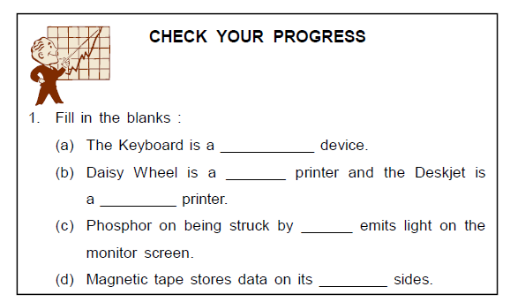
MR. SOLOMON ANAB

Slide 32
I/O INTERFACE
The I/O Interface is responsible for exchange of data between the peripherals and internal storage of the computer. Instead of directly connecting the peripherals to the system bus, an I/O Interface is used in between because,
1. The mode of operation of the different peripherals is different from the operation of the CPU and memory.
2. The data transfer rate of the peripherals is much slower compared to that of CPU and memory.
3. Peripherals use different data formats than the word format in the CPU and memory.
MR. SOLOMON ANAB

Slide 33
I/O INTERFACE (Cont.)
The interface units are hardware components between the CPU and
the peripherals that supervise and synchronize all the I/O transfers.
Two main types of interfaces are CPU Interface that corresponds to
The system bus and input-output interface that is tailored to the nature and operation of the peripheral devices.
The major functions of the I/O Interface units are :
1. Data Conversion; conversion between digital and analog signals.
2. Synchronization; synchronizes speeds of the CPU and other peripherals.
3. Device Selection; selection of the I/O device by the CPU in a queue manner.
MR. SOLOMON ANAB

Slide 34
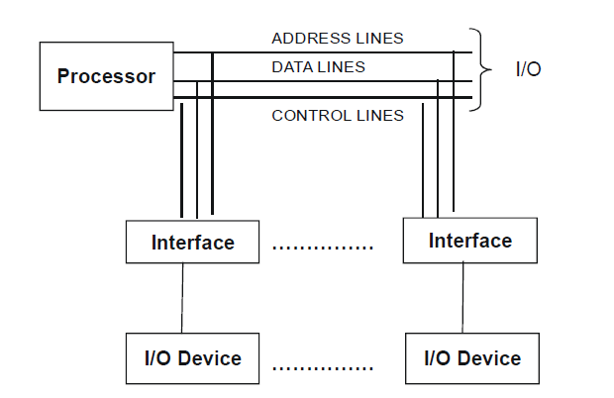
I/O INTERFACE (Cont.)
Input-Output devices are attached to the processor with the help of the
I/O Interface as shown in the figure below:
MR. SOLOMON ANAB
Processor and the I/O Interface

Slide 35
I/O INTERFACE (Cont.)
The I/O interface circuit also has an address decoder, control circuits and data and status registers. Whenever the CPU has to communicate with a particular device, it places its address in the address lines; the address decoder in the address lines then helps in recognizing the address of its connected I/O device. The I/O interface can also generate addresses associated with the device that it controls. The control circuits accept the detailed control information from the CPU. The I/O interface also holds the responsibility of data buffering. The data registers in it holds the data being transferred to and from the interface.
MR. SOLOMON ANAB

Slide 36
I/O INTERFACE (Cont.)
This is necessary as the data transfer rate into and out of the CPU or memory is quite high as compared to the peripheral devices. The status registers provides the current status information relevant to the input-output device operation. The data and status registers are connected to the data bus.
The input-output interface can detect errors and then after detection reports them to the CPU.
MR. SOLOMON ANAB

Slide 37
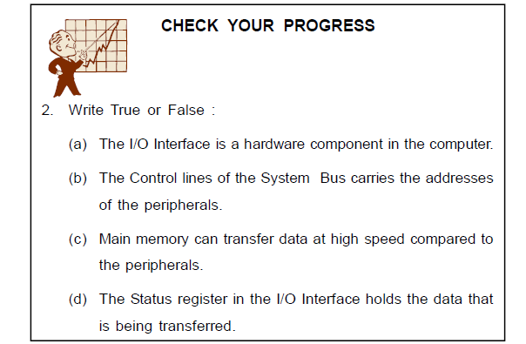
MR. SOLOMON ANAB

Slide 38
DIFFERENT I/O TECHNIQUES
There are different I/O techniques in the computer. Some may involve
the CPU for transferring data between the computer and the input output
devices and others may directly transfer data from and to the
memory units. The three possible techniques for I/O operations are :
• Programmed I/O,
• Interrupt - Driven I/O,
• Direct Memory Transfer (DMA)
MR. SOLOMON ANAB

Slide 39
Programmed I/O
In the Programmed I/O, data transfer takes place between the peripherals and the processor during program execution.
When the CPU encounters an I/O instruction, while executing a computer program, it immediately sends the address of the particular I/O device in the address lines of the I/O bus and also at the same time it issues a command to the particular I/O interface in the control lines of the I/O bus.
There are four types of commands that an interface may receive:
o Control command
o Status command
o Read command
o Write command
MR. SOLOMON ANAB

Slide 40
Programmed I/O (Cont.)
A Control command is used to activate the peripheral and tell it what to do. This command depends on the type of the particular peripheral.
A Status command is used to test the various status of the peripheral and the I/O interface.
A Read command causes the interface to get the data from the peripheral and place it in its data registers. The interface then places the data in the data lines of the bus for the processor when it requests for it.
A Write command causes the interface to transfer the data from the bus into its data registers. When it completes transferring data to its data registers, it then transmits that data to the particular I/O device.
MR. SOLOMON ANAB

Slide 41
Programmed I/O (Cont.)
In Programmed I/O, the CPU must constantly check the status of the I/O interface. That is, on issuing a command to the I/O interface, the processor must wait until the I/O operation is complete. This is a time consuming process as it keeps the CPU needlessly busy.
MR. SOLOMON ANAB

Slide 42
Interrupt- Driven I/O
An alternative to Programmed I/O method is the Interrupt-Driven method, where after issuing a command to the interface, the CPU can switch to execution of other programs in the computer. When the interface is ready for the transfer, it will immediately send an interrupt signal to the CPU. The CPU will then do the data transfer and resume back to what it was doing before it received the interrupt signal. One of the bus control lines, called an Interrupt Request Line, is dedicated for this purpose.
In this method, the advantage is that the CPU need not spend time waiting for an I/O operation to be completed, thereby increasing its efficiency.
MR. SOLOMON ANAB

Slide 43
Interrupt- Driven I/O (Cont.)
The routine that is executed when there is an interrupt request is called Interrupt Service Routine (ISR). When the CPU gets an interrupt signal, while it is executing an instruction of a program, say instruction I, it first finishes execution of that instruction.
It then stores the current contents of the Program Counter (PC), which now points to the next instruction i+1, and stores it in a memory stack. This is its return address after execution of the ISR. The control then branches to the service routine that processes the required I/O transfer.
MR. SOLOMON ANAB

Slide 44
Determining the I/O device requesting Interrupt
When the CPU receives an interrupt signal over the interrupt
request line, it must determine which I/O interface has sent it.
There are different techniques for determining this. They are:
1. Software Poll
2. Vectored Interrupt
3. Bus arbitration
MR. SOLOMON ANAB

Slide 45
Determining the I/O device requesting Interrupt (Cont.)
1. Software Poll
When the CPU detects an interrupt, it branches to an interrupt handler. This interrupt-handler poll each I/O interface to
determine which interface caused the interrupt. The interface which signaled the interrupt responds positively to it. This is time-consuming.
2. Vectored Interrupt
This is a more efficient technique which uses a daisy chain. It provides a hardware poll. The interrupts are signaled through a common Interrupt request line. The interrupt acknowledge line is daisy-chained through the I/O interface. On receiving an interrupt, CPU sends an acknowledge signal through it. The interface which sent the interrupt responds by placing its vector on the data lines.
3. Bus Arbitration
At a time only one interface can send an interrupt signal. When the CPU detects the interrupt signal, it acknowledges through the interrupt acknowledge line. The interface signaling
the interrupt then places its vector on the data lines.
MR. SOLOMON ANAB

Slide 46
Handling Multiple Interrupts
There may be multiple interrupts simultaneously. In those cases the CPU has to decide which one to service first. Priorities are thus assigned to the I/O interfaces to determine the order in which the interrupts are serviced. The devices having higher speeds such as the disks are given higher priorities, while the slower devices such as keyboards are given low priority. Also higher priority is given to the interrupts which if delayed may cause serious consequences. So, when two device interfaces sends interrupt requests to the processor at the same time, the device having higher priority will be serviced first.
MR. SOLOMON ANAB

Slide 47
Direct Memory Access
When large blocks of data are to be transferred between memory and high-speed I/O devices, a more efficient approach is used.
This alternative technique is the Direct Memory Access (DMA) technique. It eliminates the continuous intervention of the CPU in transferring data.
DMA transfers are performed by a DMA controller, which is a control unit in the I/O interface. This unit carries out the functions of the processor when accessing the main memory during the data transfers. In DMA transfers, the controller takes control of
the memory buses from the CPU and does the transfer between the peripheral and the memory.
MR. SOLOMON ANAB

Slide 48
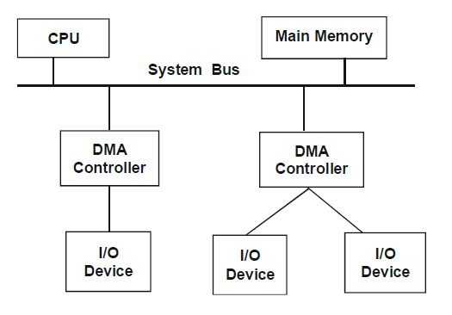
Direct Memory Access (CONT.)
DMA Controllers in a Computer System
MR. SOLOMON ANAB

Slide 49
Direct Memory Access (CONT.)
When the CPU gets an instruction that involves huge amount of data transfer while executing a computer program , it issues a command to the DMA Controller sending the address of the I/O device, the number of words to be transferred and whether a
read/write operation is to be performed. Thus the DMA, CPU just initializes the data transfer and become free for other works. i.e., the data transfer operation is completed by the DMA controller without the continuous involvement of the CPU.
The transfer may be in two ways / modes:
Burst Transfer : By Burst Transfer a block of words is transferred in a continuous burst. This mode is needed for fast devices where data cannot be stopped until the entire block is transferred. Then the controller informs the CPU by sending an interrupt signal.
MR. SOLOMON ANAB

Slide 50
Direct Memory Access (CONT.)
Cycle Stealing : The controller transfers one word at a time and return the bus control to the CPU. The CPU then temporarily suspends its operation for one memory cycle to allow the DMA transfer to steal its memory cycle.
The DMA controller uses a register for storing the starting address of the word to be transferred, a register for storing the word count of the transfer and another register contains the status and the control flags. The status and the control registers are shown below
MR. SOLOMON ANAB

Slide 51

Direct Memory Access (CONT.)
IRQ : Interrupt Request
IE : Interrupt Enabled
R/W : Read or Write operation
The IRQ bit is set to 1 when the controller has requested an
interrupt. When the data transfer is completed, it sets the IE to
1 thereby to raise an interrupt. When it is ready for the next
command, after completion, the Done bit is set to 1. When the
R/W bit is 1, the controller performs a Read operation, otherwise
a Write operation is performed.
MR. SOLOMON ANAB

Slide 52
Direct Memory Access (CONT.)
Whenever a word is transferred, the DMA Controller increments its address register to point to the next word to be transferred and decrements its word count register. When finally the word count becomes zero, the controller stops any further transfer and informs the CPU by raising an interrupt.
MR. SOLOMON ANAB

Slide 53
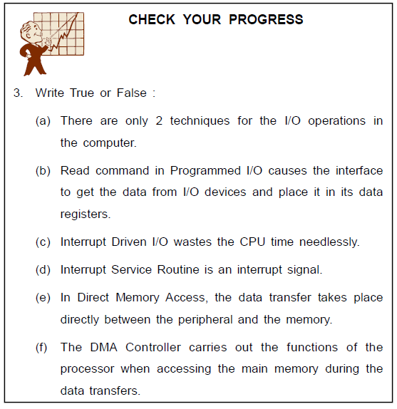
MR. SOLOMON ANAB

Slide 54
I/O PROCESSOR
An Input – Output processor (IOP) is a processor in addition to the CPU. It directly communicates with the input and output devices. The IOP need not interfere with the tasks of the CPU as they themselves can fetch and execute the instructions. Other
than fetching and executing I/O instructions the Input Output processor can also do processing tasks like arithmetic, logic and branching.
Data from the devices are first collected into the IOP and then transferred to the memory directly by stealing one memory cycle from the CPU. Similarly data is transferred from memory to IOP first and the the gathered data is sent to the respective I/O
devices.
MR. SOLOMON ANAB

Slide 55
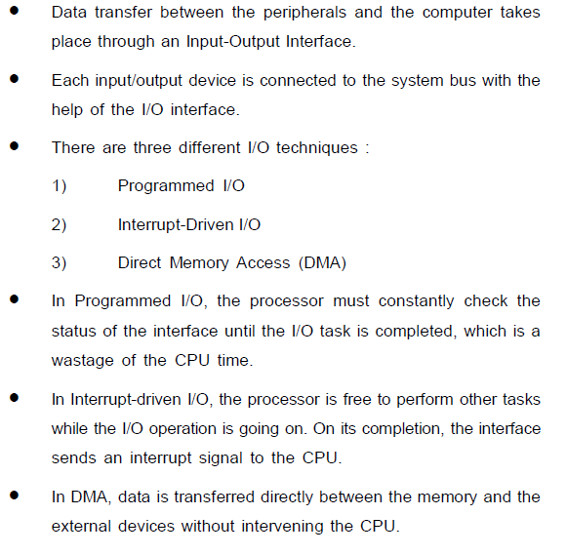
SUMMARY
MR. SOLOMON ANAB

Slide 56
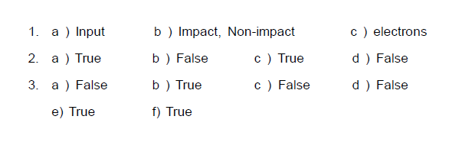
ANSWERS TO CHECK YOUR PROGRESS
MR. SOLOMON ANAB

